Slide 1
A Taste of Fisheries Science Lecture 2: Survey says?
Dr. Heather Bowlby and Dr. David Keith
Fisheries and Oceans, Canada

Slide 2
Quick overview of what we are trying to do
What are the objectives of traditional Fisheries Science?
In the area you want to go fishing, how many fish are there?
Should be we happy or worried about this number?
Given this number, how many can you sustainably (optimally) remove via a fishery?
How do we achieve this objective?
In theory, it’s pretty simple…
Go out and count your species in the area of interest (Survey – Fishery Independent data).
Go out and count how many fish were removed by the fishery (Fishery Dependent data)
Plug (1) and (2) into a (sometimes) fancy statistical model (Stock Assessment Model).
Figure out what a safe number of fish to harvest is (Precautionary Approach – Reference Points, etc)
Notes:
Four lecture topics are identified by red boxes
- People is in bold because there are direct implications of the science on the people that it impacts.

Slide 3
Step 1: Surveys
An exceptionally brief introduction
Notes:
Discussion with the group.

Slide 4

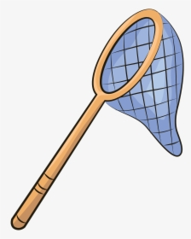

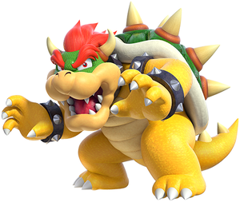


What is a fisheries independent survey?
Why fisheries surveys are so much harder than terrestrial surveys…
Imagine you are tasked with surveying mushrooms in the forest
Unfortunately, you have a few constraints this year.
You are flying over the area in a helicopter
Note you have to pay for the flight time and the crew
You can only survey when it is so foggy you can’t see the forest
Or you must be blindfolded
You have a large butterfly net to do your sampling
Good luck and have fun!
Notes:
Four lecture topics are identified by red boxes
- People is in bold because there are direct implications of the science on the people that it impacts.

Slide 5

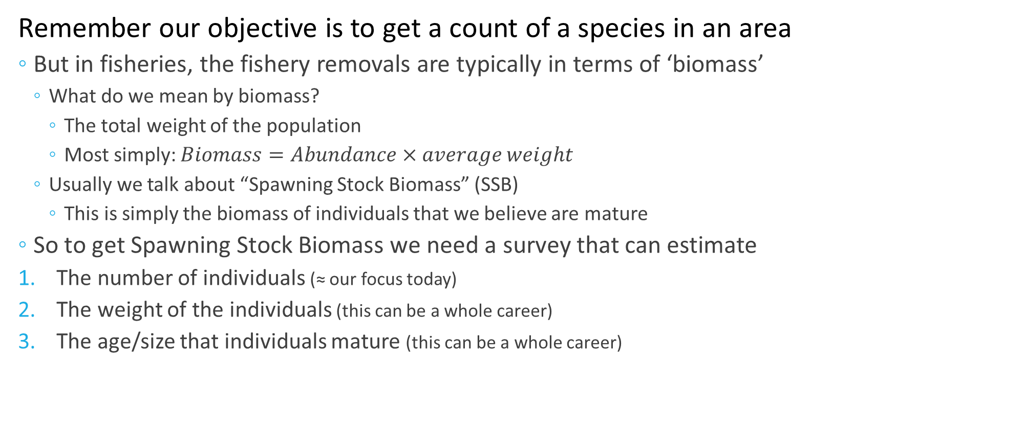
What is a fisheries independent survey?
Remember our objective is to get a count of a species in an area
But in fisheries, the fishery removals are typically in terms of ‘biomass’
What do we mean by biomass?
The total weight of the population
Most simply: $Biomass=Abundance×average weight$
Usually we talk about “Spawning Stock Biomass” (SSB)
This is simply the biomass of individuals that we believe are mature
So to get Spawning Stock Biomass we need a survey that can estimate
The number of individuals (≈ our focus today)
The weight of the individuals (this can be a whole career)
The age/size that individuals mature (this can be a whole career)
30
50
10
60
10
20
Notes:
Four lecture topics are identified by red boxes
- People is in bold because there are direct implications of the science on the people that it impacts.

Slide 6
Survey Lingo
Vessel effects
Domain
Randomization
Stock
Stratification
Biomass
Selectivity
Cathability
Tow
Drege
Sub-sample
Station
Trawl
Mensuration
Survey Design
Standardization
Allocation
Notes:
Why is this critical for stock assessment? I contend that unlike ecology, the terminology used in fisheries science has specific definitions and these matter when trying to assess a stock. For example:
Is a stock the same as a population? The answer to this will tell you if emigration and immigration can be ignored in your assessment model.
Does a cohort describe biomass?
Is catch composition the same as age structure? No – the catch composition depends on the age structure, but is modified by selectivity
How is F related to U; how is S related to M? Fishing mortality and exploitation are not synonymous and we will tell you why.

Slide 7
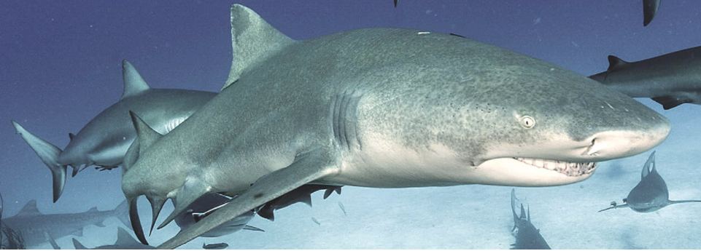
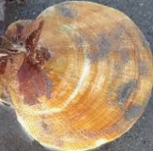
Dusky Scallop Shark Survey
Newly Targeted Species Gulf of Maine
Science advice required, need to get a biomass estimate of DSS.

Slide 8
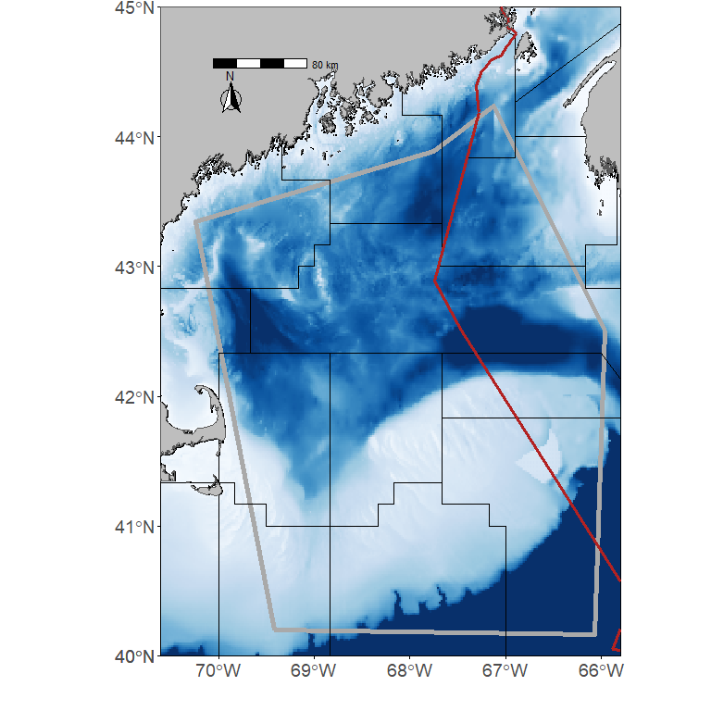
Survey Design 1.01
OK, so we are going to design a survey, what do we need to think about?
What is our survey domain?
Typically, the general area of interest is out of your control
Often the area chosen has little biological justification
History, socio-economics, and political considerations
What are some implications of this?
Notes:
Four lecture topics are identified by red boxes
- People is in bold because there are direct implications of the science on the people that it impacts.

Slide 9
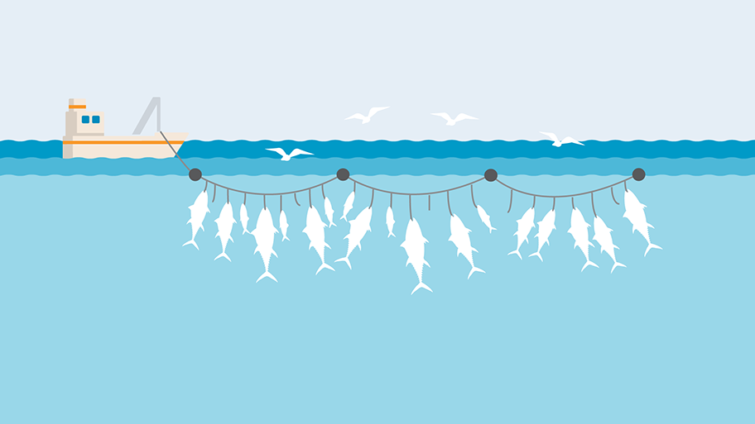

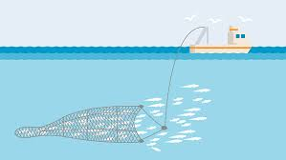
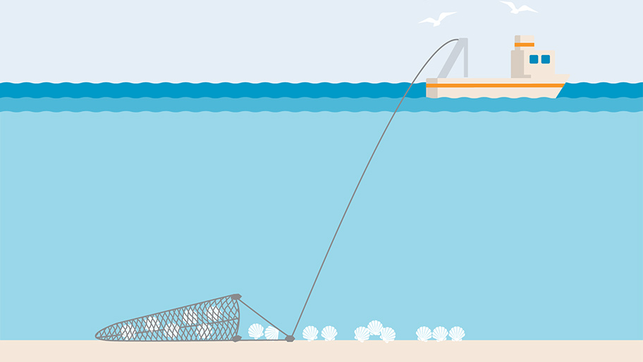
Survey Design 1.02
OK, so we are going to design a survey, what do we need to think about?
Gear Type
What is the appropriate type of gear?
Longline, trawl, drege, etc?
Need to think about life history of species you are sampling
This comes down to the concept of catchability
Two pieces to this
What proportion of the individuals that the gear encounters are captured
Using a longline on Scallop means catchability = 0
Selectivity
You only capture individuals in the population with certain characteristics
Most common problem is missing smaller individuals
In scallop, I think we miss intermediate sizes (they swim!)
Longline
Hey Hal, look at the stupid fish!
Trawl
Dredge
Notes:
Four lecture topics are identified by red boxes
- People is in bold because there are direct implications of the science on the people that it impacts.

Slide 10
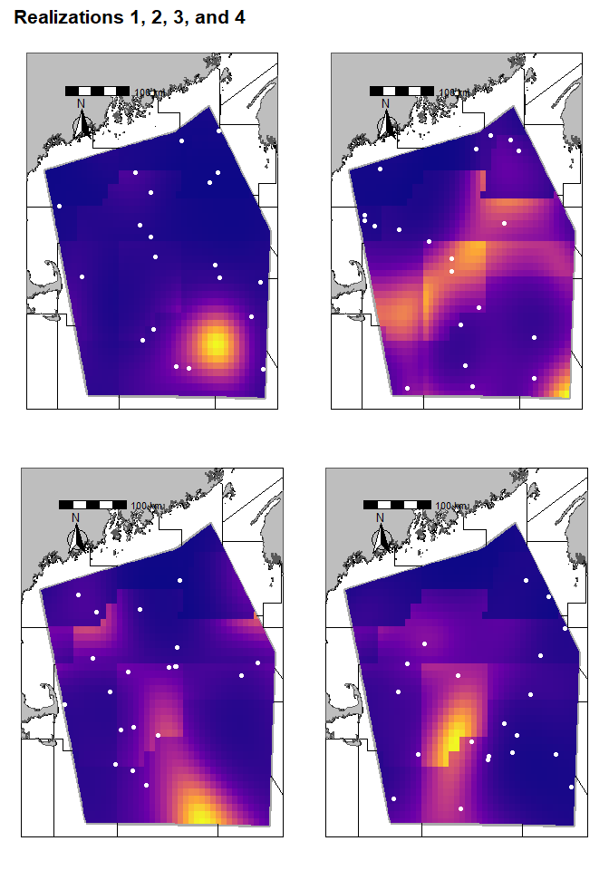
Survey Design 1.02
OK, so we are going to design a survey, what do we need to think about?
Station Allocation
Station design
Random, fixed stations, stratified survey?
Random allocation
Pros
Easy to implement
Statistics to generate indices are easy to calculate
Cons
Coverage often suboptimal
Generally, less precise than other methods
Notes:
Four lecture topics are identified by red boxes
- People is in bold because there are direct implications of the science on the people that it impacts.

Slide 11
Survey Design 1.02
OK, so we are going to design a survey, what do we need to think about?
Station Allocation
Station design
Random, fixed stations, stratified survey?
Fixed station (often in a grid)
Pros
Good for monitoring a location
Simple to implement
Cons
Statistically dubious for some people
Are you sampling the ‘same’ location each year?
Notes:
Four lecture topics are identified by red boxes
- People is in bold because there are direct implications of the science on the people that it impacts.

Slide 12
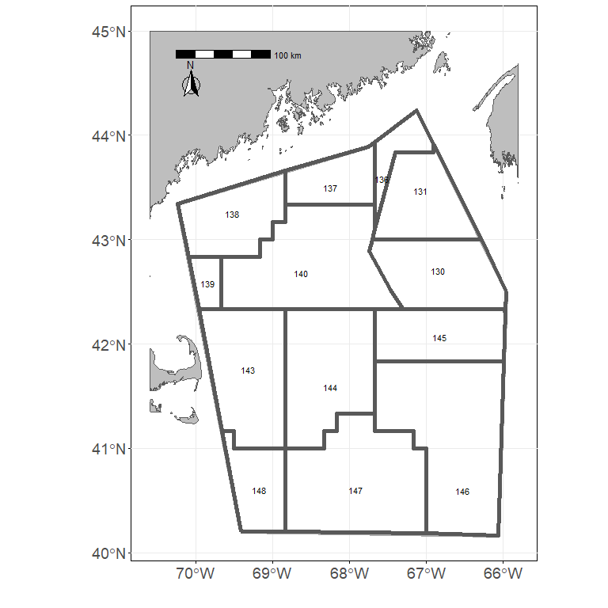
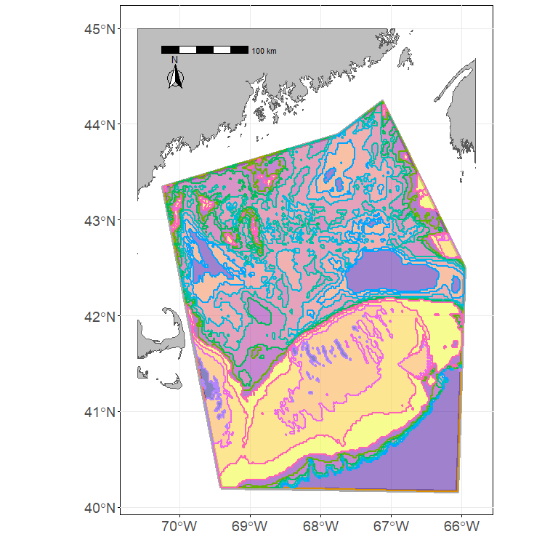
Survey Design 1.02
OK, so we are going to design a survey, what do we need to think about?
Station Allocation
Station design
Random, fixed stations, stratified survey?
Stratified Survey
Concept is to break the survey domain up into ‘homogenous’ bits (strata)
Depth is a common stratifying variable
Pros
Should result in more precise estimates
Often leads to better coverage than random designs
Cons
How do you define a ‘homogeneous’ strata?
Statistics are more complex
Need to decide how many stations go in each strata
Need coverage in all the ‘strata’
Notes:
Four lecture topics are identified by red boxes
- People is in bold because there are direct implications of the science on the people that it impacts.

Slide 13
Survey Design 1.02
OK, so we are going to design a survey, what do we need to think about?
How many stations
How many sampling stations do you need?
More stations = more $$, what is your budget?
When should you survey?
During spawning, before spawning?
Conflicts with other fisheries/users
Seasonal variability
Notes:
Four lecture topics are identified by red boxes
- People is in bold because there are direct implications of the science on the people that it impacts.

Slide 14
Survey Design Tutorial
Open the file Survey_tutorial.Rmd and pop down to line 83
Change the number of stations in the survey and explore how this impacts your estimates (n.tows)
Note that we compare 3 different survey allocation schemes in the results
Random allocation where the stations randomly get placed inside the survey domain
NAFO allocation where stations are located inside the NAFO strata
Depth allocation where stations are located inside ‘depth’ strata
For example, 0-25 meters is one strata, 26-50 meters is another strata
We’ve also given you the option to change how the biomass is distributed across the area (b.dist)
Biomass is ‘randomly’ allocated across survey domain
Uses a random field, so isn’t really random, you’ll see discrete ‘patches’ of high/low biomass
NAFO stratification
Biomass tends to be higher/lower in specific NAFO strata
Depth stratification
Biomass tends to be higher in 25-100 meter depths (on Georges Bank)
You can also change the number of times you runs the simulation (n.realizations)
One simulation can be misleading, so try running with different numbers of simulations (I’ve run up to 250, it takes several minutes though)
Notes:
Four lecture topics are identified by red boxes
- People is in bold because there are direct implications of the science on the people that it impacts.

